Slide 1

Dynamics 365 F&O Business Events From End to Start to End

Slide 2
Synopsis
In this session we’ll go over several different use cases for how to implement business events, how to add your own business events from scratch, what to do once you have your business events communicating and what other platforms offer in terms of message processing and handling. We’ll discuss how to use messaging to an Azure Service Bus Queue and topic, HTTPS as well as Power Automate.
PowerPoint available for download at https://github.com/NathanClouseAX/CommunityPresentations/tree/master/2021

Slide 3
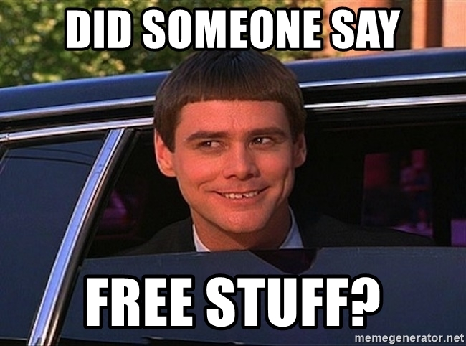
Free Stuff
Gift Card Give Away!

Slide 4

Nathan Clouse
Technical Architect enVista Corp.
Microsoft Business Applications MVP (2x)
nclouse@envistacorp.com
www.atomicax.com
@NathanClouseAX

Slide 5

Sukrut Parab
Senior Architect Hitachi Solutions.
Microsoft Business Applications MVP
sparab@hitachisolutions.com
Sukrut Parab - Microsoft Dynamics Community
@SukrutParab

Slide 6
Topics
Business Event Catalog
Endpoints
Azure Service Bus queue
Azure Service Bus Topic
Azure Event Grid
Azure Event Hub
Power Automate
HTTPS
Azure Blob Storage
Active Events
Inactive Events
Errors and error handling
Security
Samples
Notes:
SP: intro, business event catalog, endpoints to SB Topic
NC: from Event Grid to end

Slide 7
What is a business event?
Alerts outside system of an event via notification.
Outside systems can receive the message and action upon it
Can be workflow related or not
Some processes supported OOTB
Anything not in the catalog should be created custom

Slide 8
Catalog
System administration > Set up > Business events
List all available business events
Static processes like an AR payment has been posted
More dynamic such as a events related to a specific configured workflow in F&O
Activate
Download Schema

Slide 9
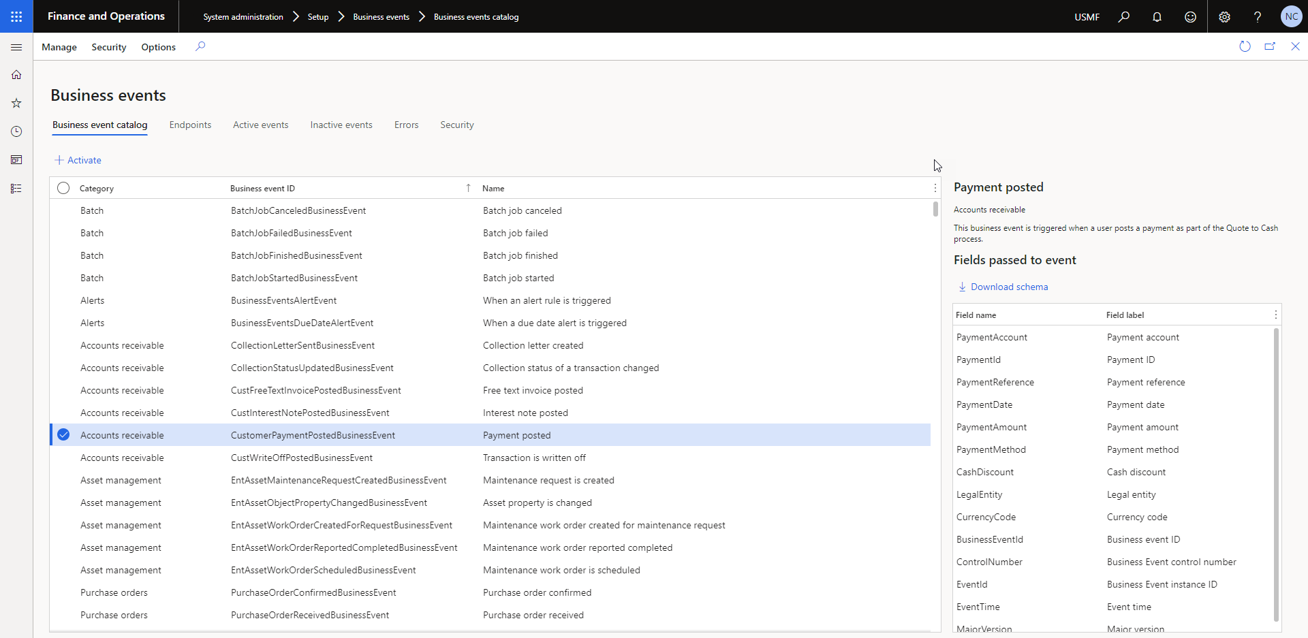

Slide 10
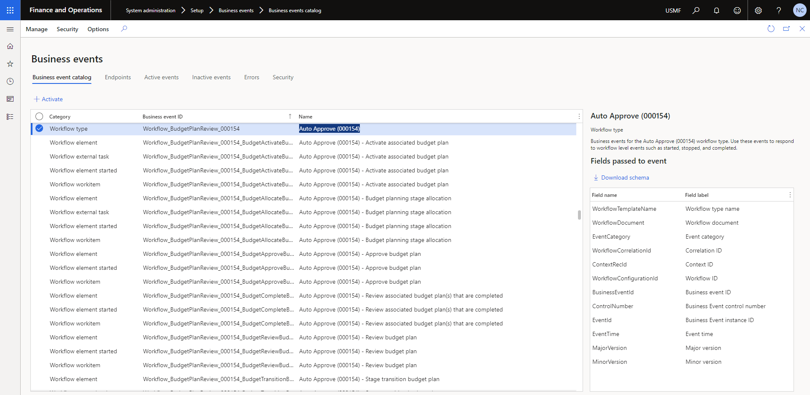

Slide 11
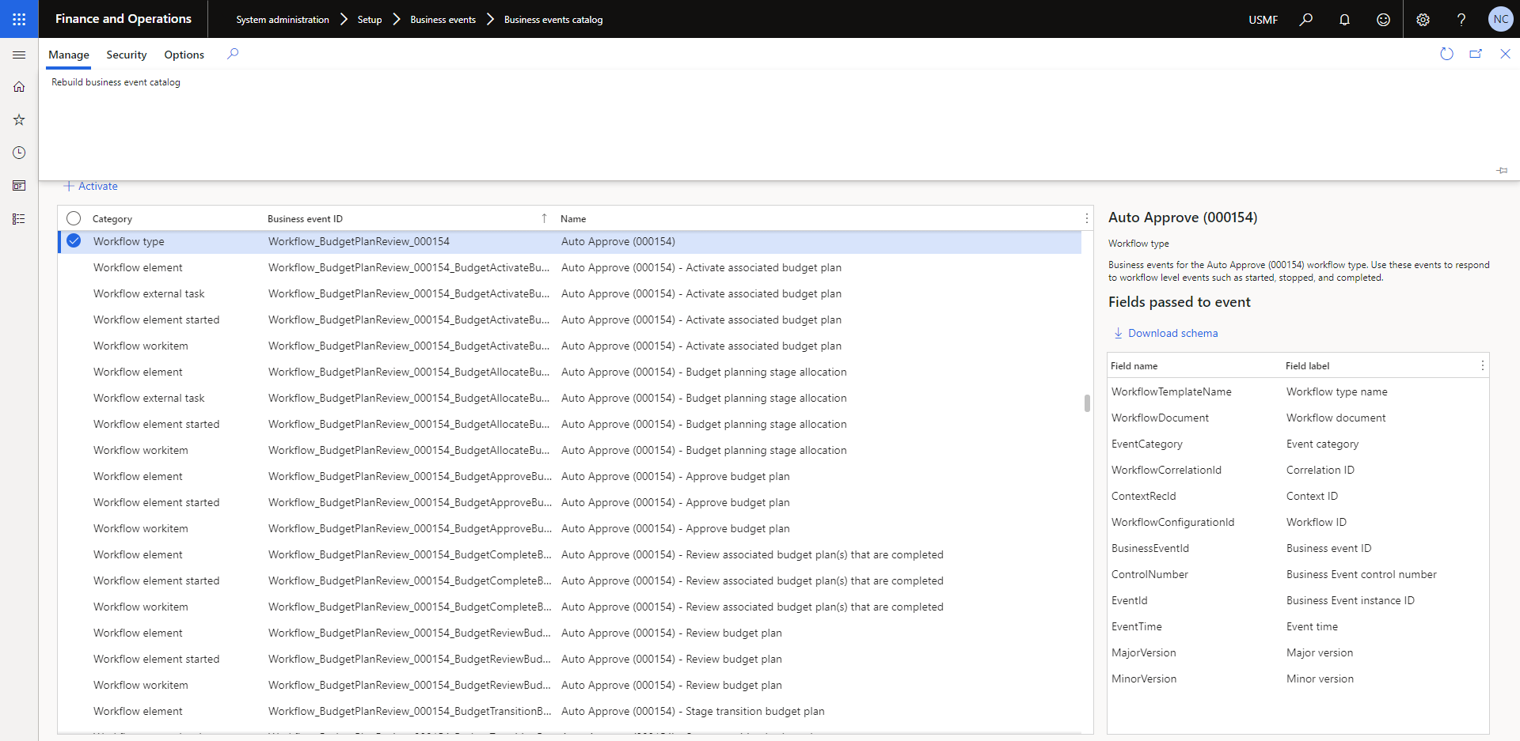

Slide 12
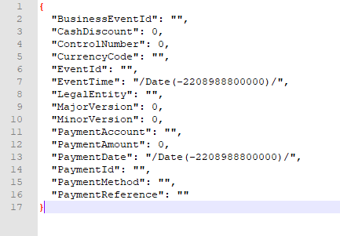
Schema Sample – AR Payment Posted

Slide 13

Endpoints
Azure Service Bus queue
Azure Service Bus Topic
Azure Event Grid
Azure Event Hub
Power Automate
HTTPS
Azure Blob Storage
Custom – Build Your Own

Slide 14
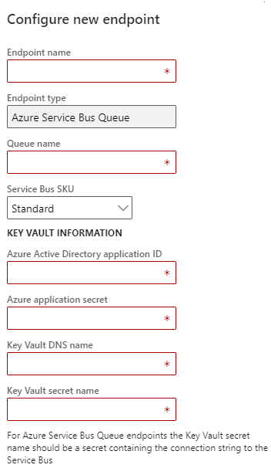
Azure Service Bus Queue
Have to use Key Vault
Must be familiar with Azure Portal to set this up
https://docs.microsoft.com/en-us/dynamics365/fin-ops-core/dev-itpro/business-events/home-page#create-an-azure-service-bus-queue-endpoint

Slide 15
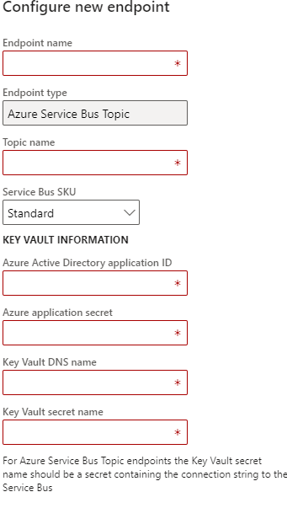
Azure Service Bus Topic
Have to use Key Vault
Must be familiar with Azure Portal to set this up
https://docs.microsoft.com/en-us/dynamics365/fin-ops-core/dev-itpro/business-events/home-page#create-an-azure-service-bus-queue-endpoint

Slide 16

Azure Service Bus Queue / Topic
Queue – can only have one consumer
Topic – can have multiple subscribers
Scenario: A customer payment has been posted and you’d like to know when this happens

Slide 17
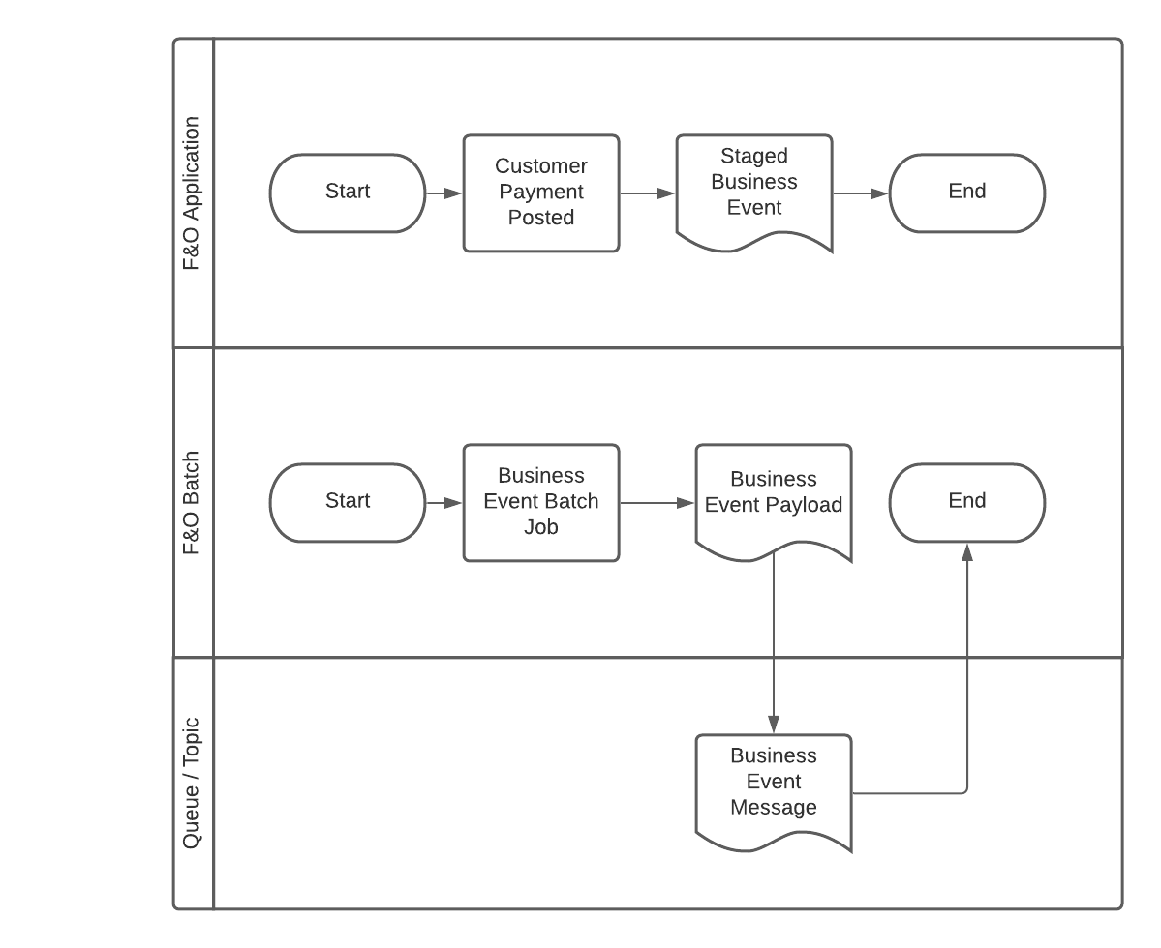
Azure Service Bus Queue / Topic

Slide 18
Azure Service Bus Queue / Topic

Slide 19
Azure Service Bus Queue / Topic

Slide 20
Azure Service Bus Queue / Topic

Slide 21
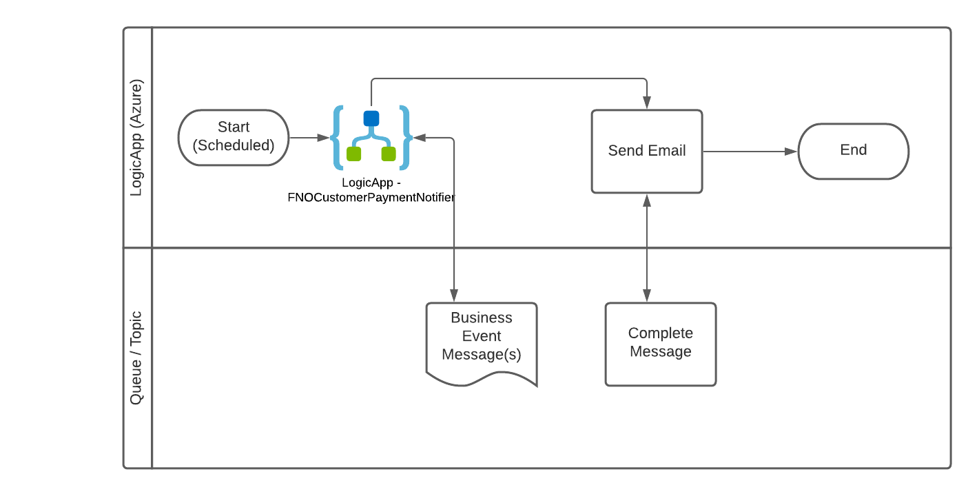
Azure Service Bus Queue / Topic

Slide 22
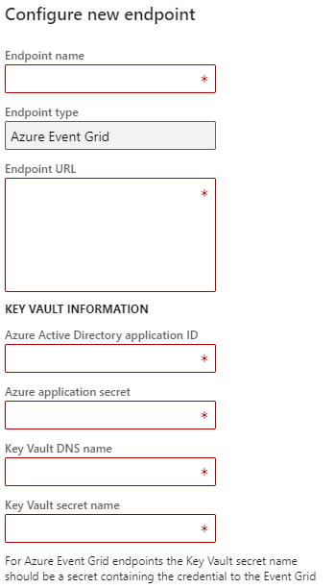
Azure Event Grid
Same constraints as Azure Service Queue

Slide 23
Azure Event Grid
Concepts
Events
Event sources
Topics
Event subscriptions
Event handlers
Capabilities'
Simple
Advanced Filtering
Pay Per Event
Scenario: A customer payment has been posted and you’d like to know when this happens
Notes:
Events - What happened.
Event sources - Where the event took place.
Topics - The endpoint where publishers send events.
Event subscriptions - The endpoint or built-in mechanism to route events, sometimes to more than one handler. Subscriptions are also used by handlers to intelligently filter incoming events.
Event handlers - The app or service reacting to the event.
--
Simplicity - Point and click to aim events from your Azure resource to any event handler or endpoint.
Advanced filtering - Filter on event type or event publish path to make sure event handlers only receive relevant events.
Fan-out - Subscribe several endpoints to the same event to send copies of the event to as many places as needed.
Reliability - 24-hour retry with exponential backoff to make sure events are delivered.
Pay-per-event - Pay only for the amount you use Event Grid.
High throughput - Build high-volume workloads on Event Grid.
Built-in Events - Get up and running quickly with resource-defined built-in events.
Custom Events - Use Event Grid to route, filter, and reliably deliver custom events in your app.

Slide 24
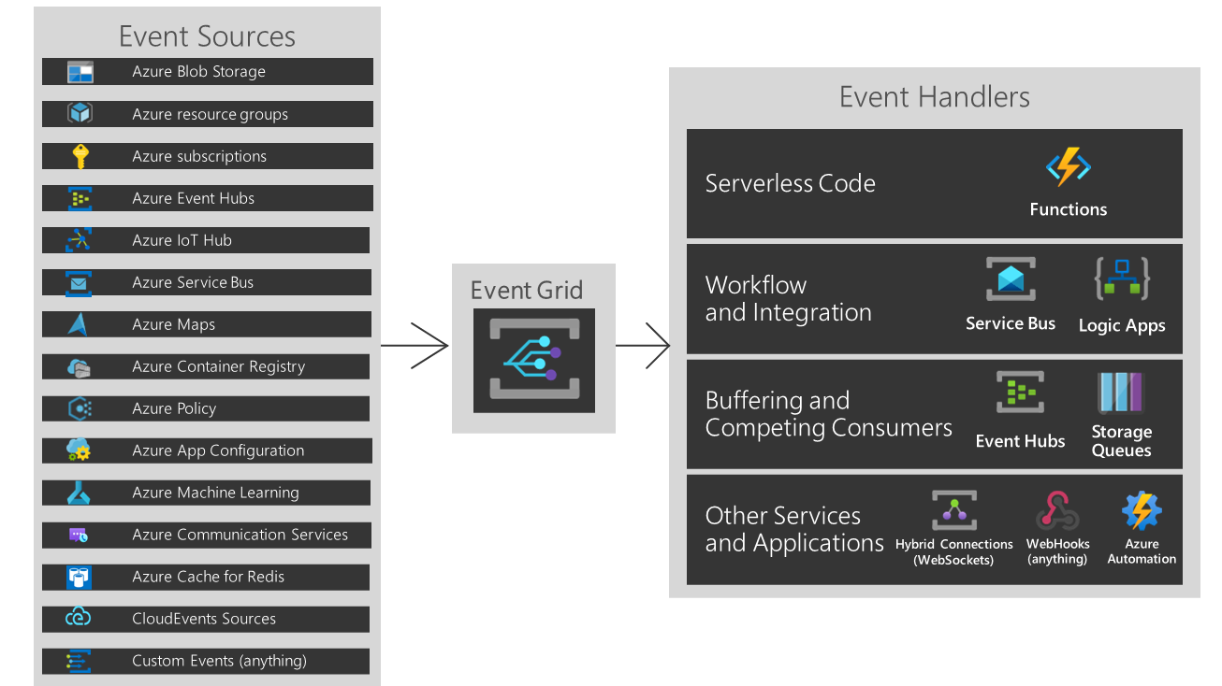
Azure Event Grid

Slide 25

Azure Event Grid

Slide 26
Azure Event Grid

Slide 27
Azure Event Grid

Slide 28
Azure Event Grid

Slide 29
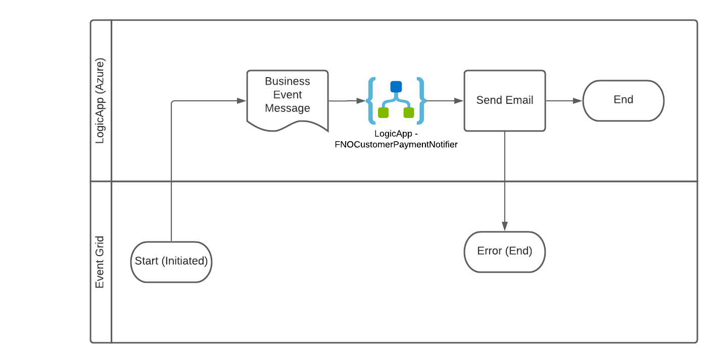
Azure Event Grid

Slide 30
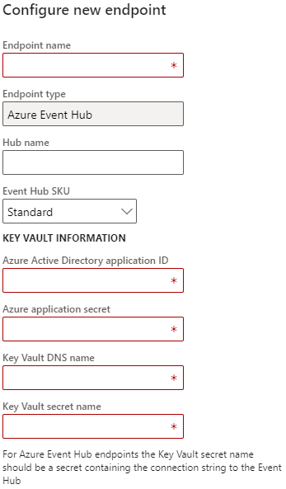
Azure Event Hub
Like Event Grid but more than one

Slide 31
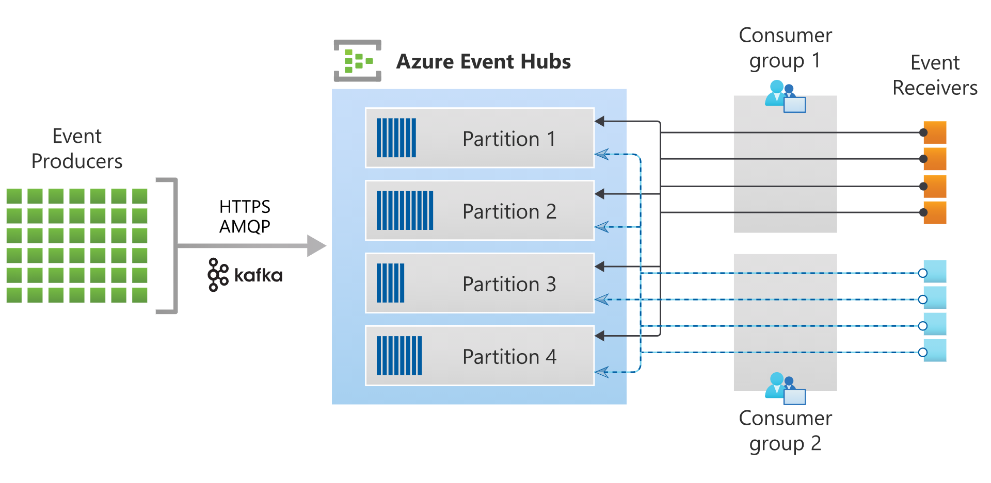
Azure Event Hub

Slide 32
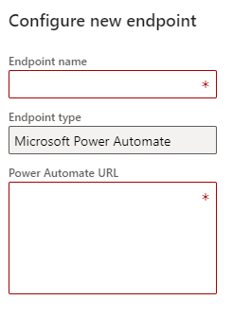
Power Automate
Formerly “Flow”
Can be configured from Power Automate completely
Power User focused and simple to configure

Slide 33
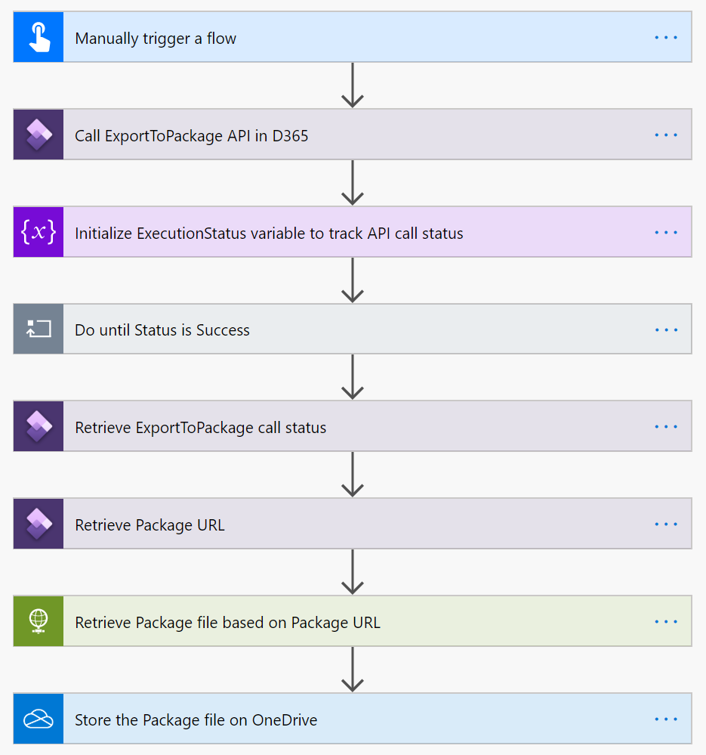
Power Automate

Slide 36
Power Automate

Slide 37
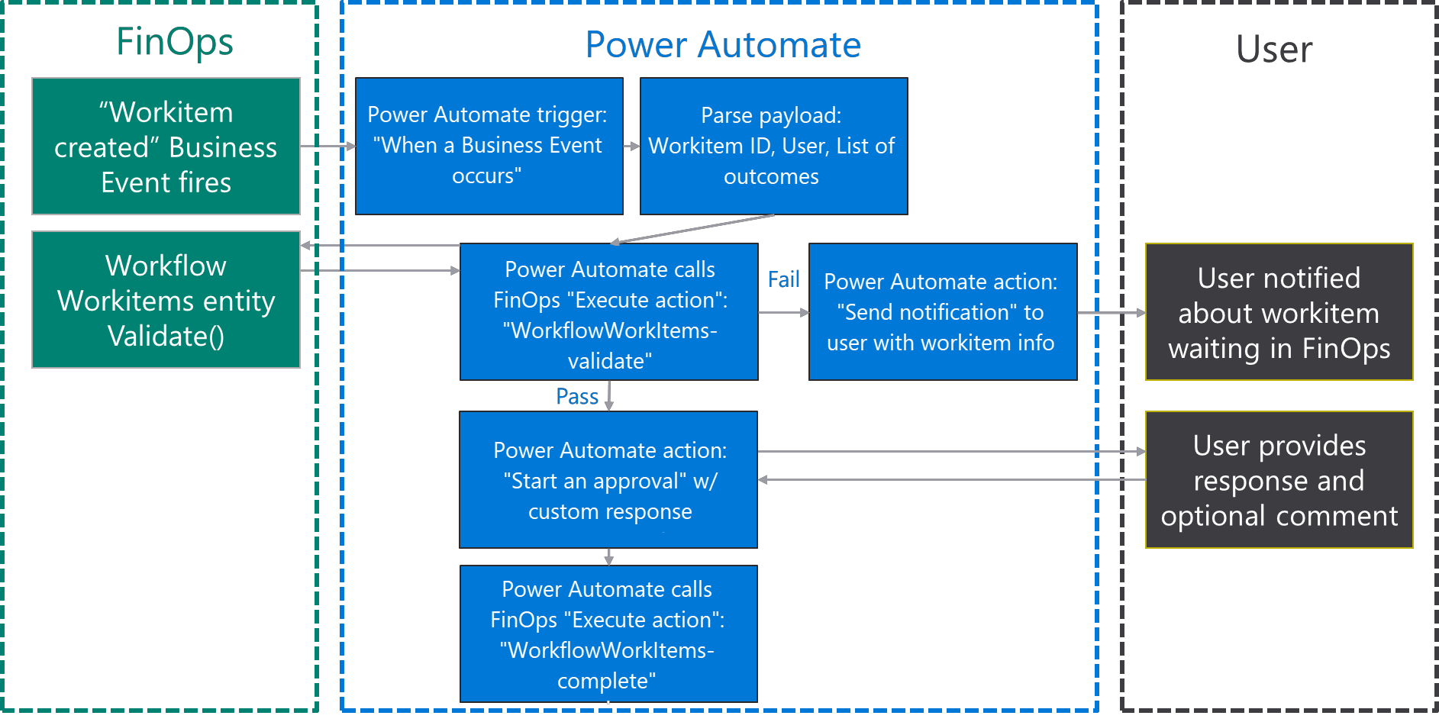
Power Automate & Workflows

Slide 38
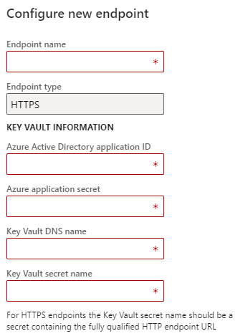
HTTPS
Can be any HTTPS receiver
Ie; Power Automate, Azure Function App, Drupal Webhook, just about anything that can accept JSON
Receiver must accept message schema from F&O

Slide 39
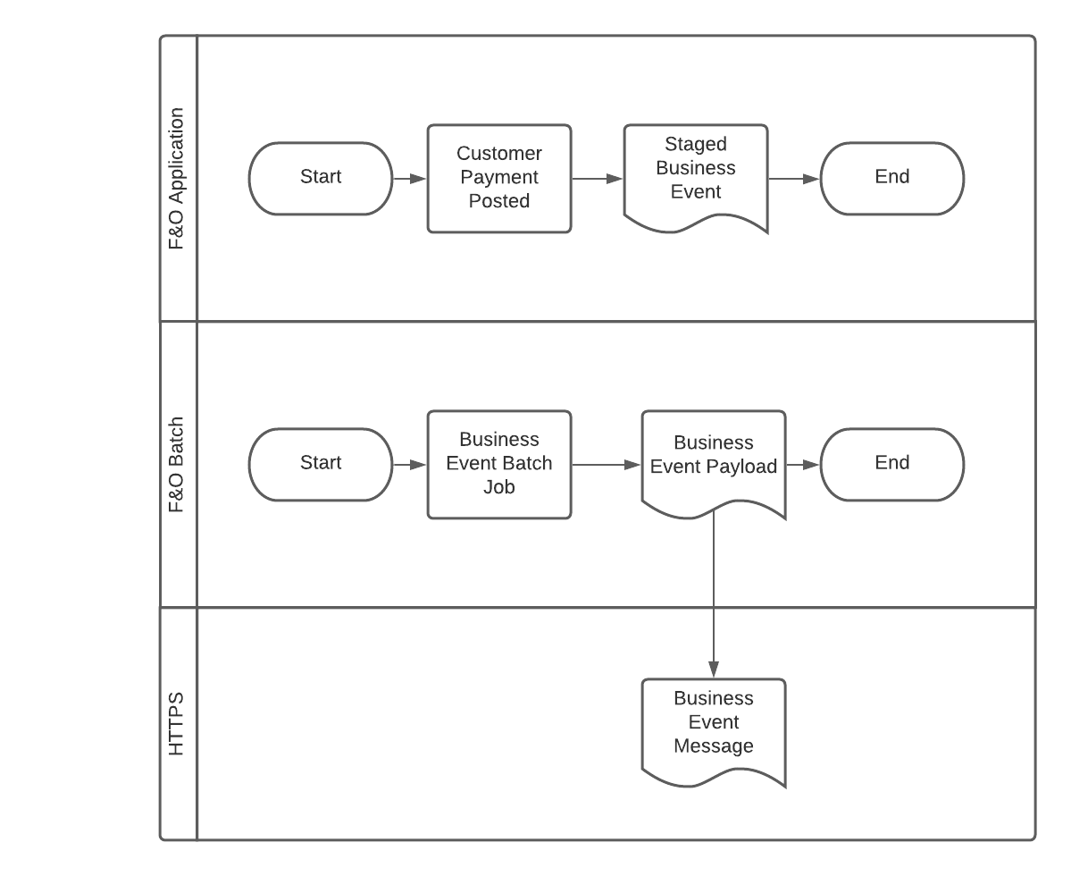
HTTPS

Slide 40
HTTPS

Slide 41
HTTPS

Slide 42
HTTPS

Slide 43
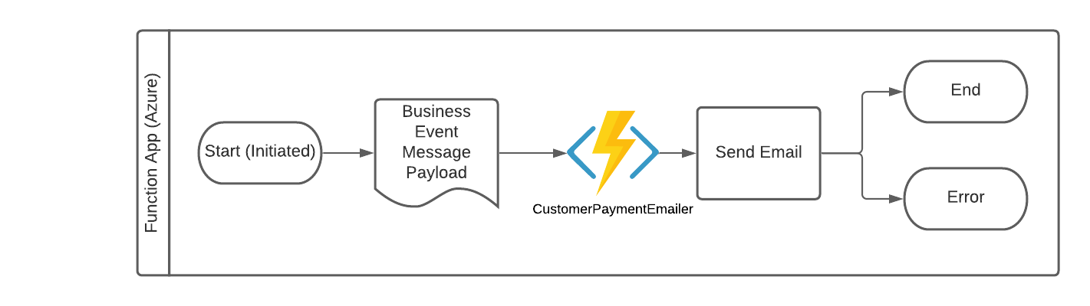
HTTPS

Slide 44
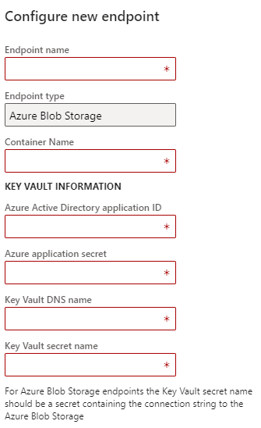
Azure Blob Storage
File based storage in container
Can treat messages just like files

Slide 45
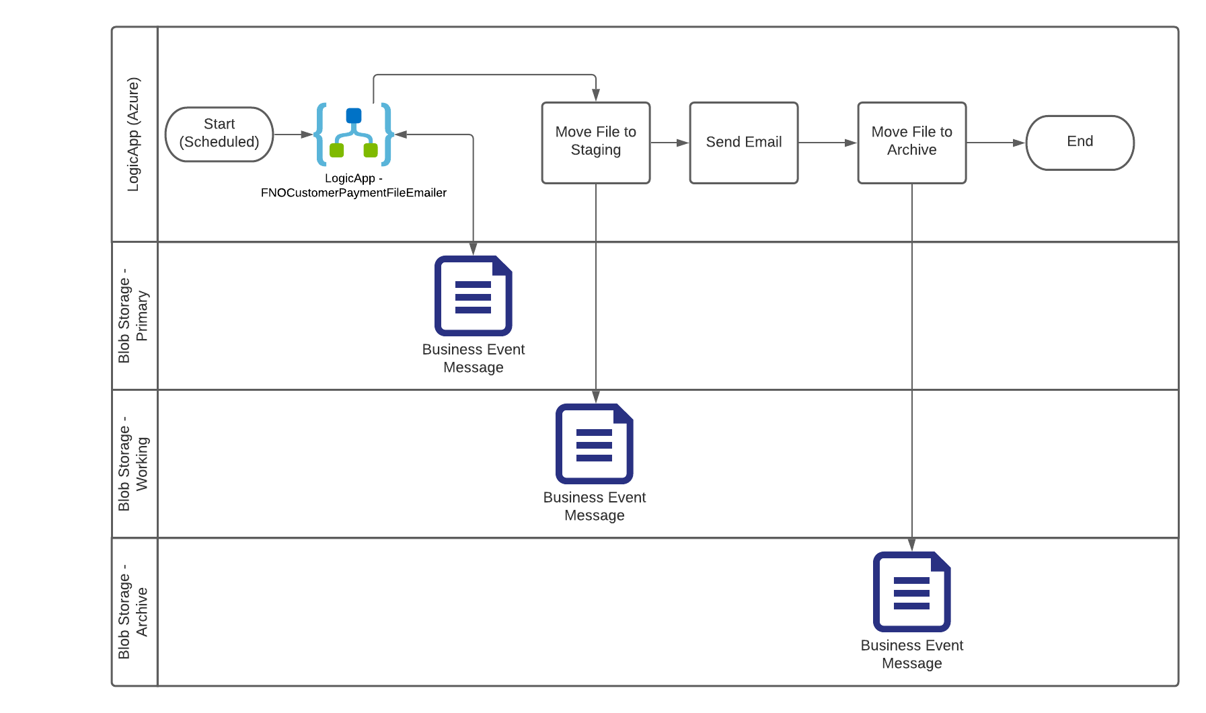
Azure Blob Storage

Slide 46
Azure Blob Storage

Slide 47
Azure Blob Storage

Slide 48

Forms Pro
Create a survey and email it to customers when an event occurs in F&O
Ie; customer satisfaction survey
Power Automate to email a link to the survey

Slide 49

Custom
Build your own if your needs aren’t already covered above
Direct connection to Target rather than through 3rd party
Ie; post directly to Discord rather than to Function App that posted to Discord

Slide 50
When Should I use Azure Service Bus Queue / Topic?
Need Ordering, Dupe detection and instant consistency
Reliable async message delivery
Advanced Features like FIFO, batching, transaction focused, dead lettering with time controls
Start with this first

Slide 51
When Should I use Azure Event Grid
Publisher sends events but don’t/can’t specifically care how they are processed; Order doesn’t matter
Need eventing from source to target – no polling
Connects Event with Subscriber in near real time
Dynamically scalable
Start with this when volume or complexity has gone beyond “low” or “simple”

Slide 52

When Should I use Azure Event Hub
Similar to an Event Grid
Low latency
Millions of events per second
Big Data streaming platform
Single solution for rapid data processing, repeated replay of stored raw data

Slide 53

But what if I don’t see the business event I want?
Write a custom business event
Framework is extensible and easy to work with
Intent and Fidelity are important
Not a data export platform

Slide 54

Custom Business Events
Easily Defined
Action or Event based
Not too narrowly or broadly defined
Only something we want a 3rd party to react to
Not Data Transfer, use DMF for that

Slide 55
Custom Business Events - Fidelity
Durable – no false business events.
Ie; only send PO Invoice event if the Invoiced posted with no errors
Targeted – Designed to meet the requirements for the consumer in the story
Ie; send event high level info related to a PO Invoices, not the entire entity.
Noiseless – not specifically filtered in code
Ie; Send for all PO invoices, not specific ones

Slide 56
What is and is not a Business event?
Send an event when any field on a Customer Changes? IS NOT
Send relevant info for an invoice journal that was posted? IS
Send all data related to a Sales Order Invoice including line information? IS NOT.
When a purchase order is confirmed by a vendor? IS

Slide 57
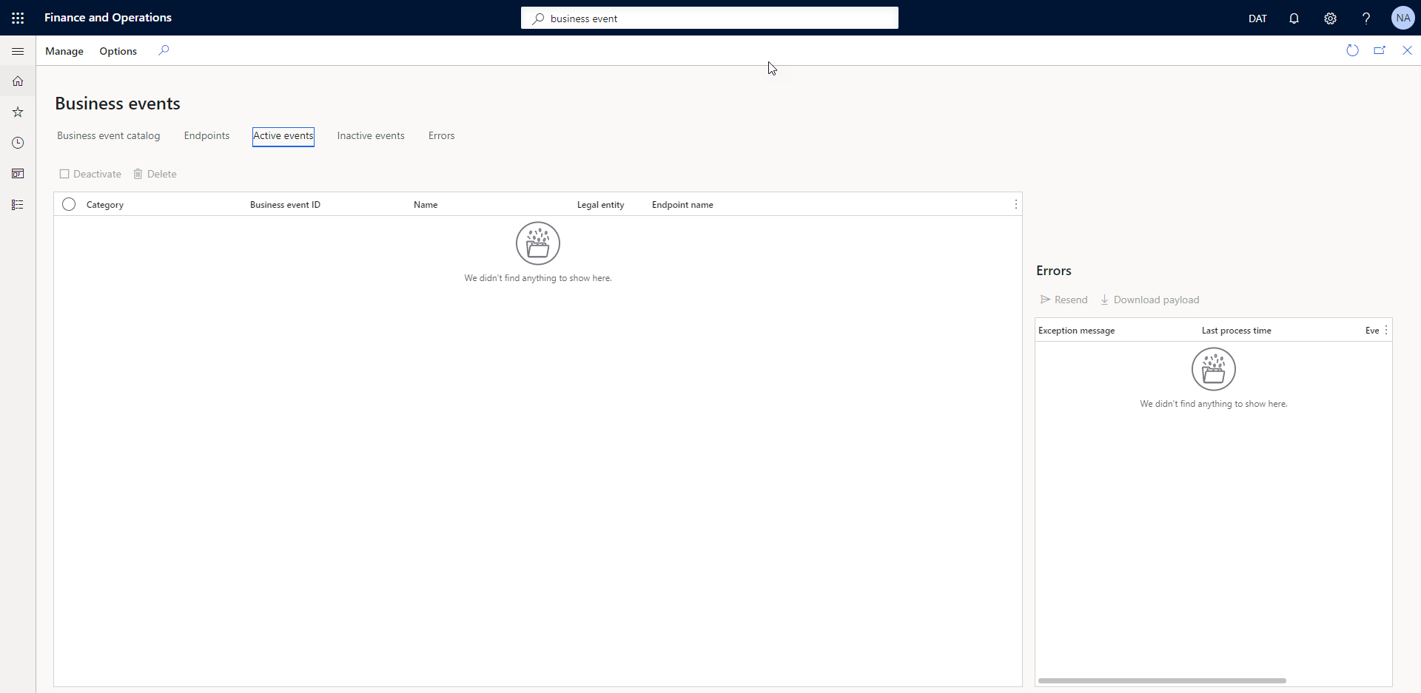
Active Events

Slide 58
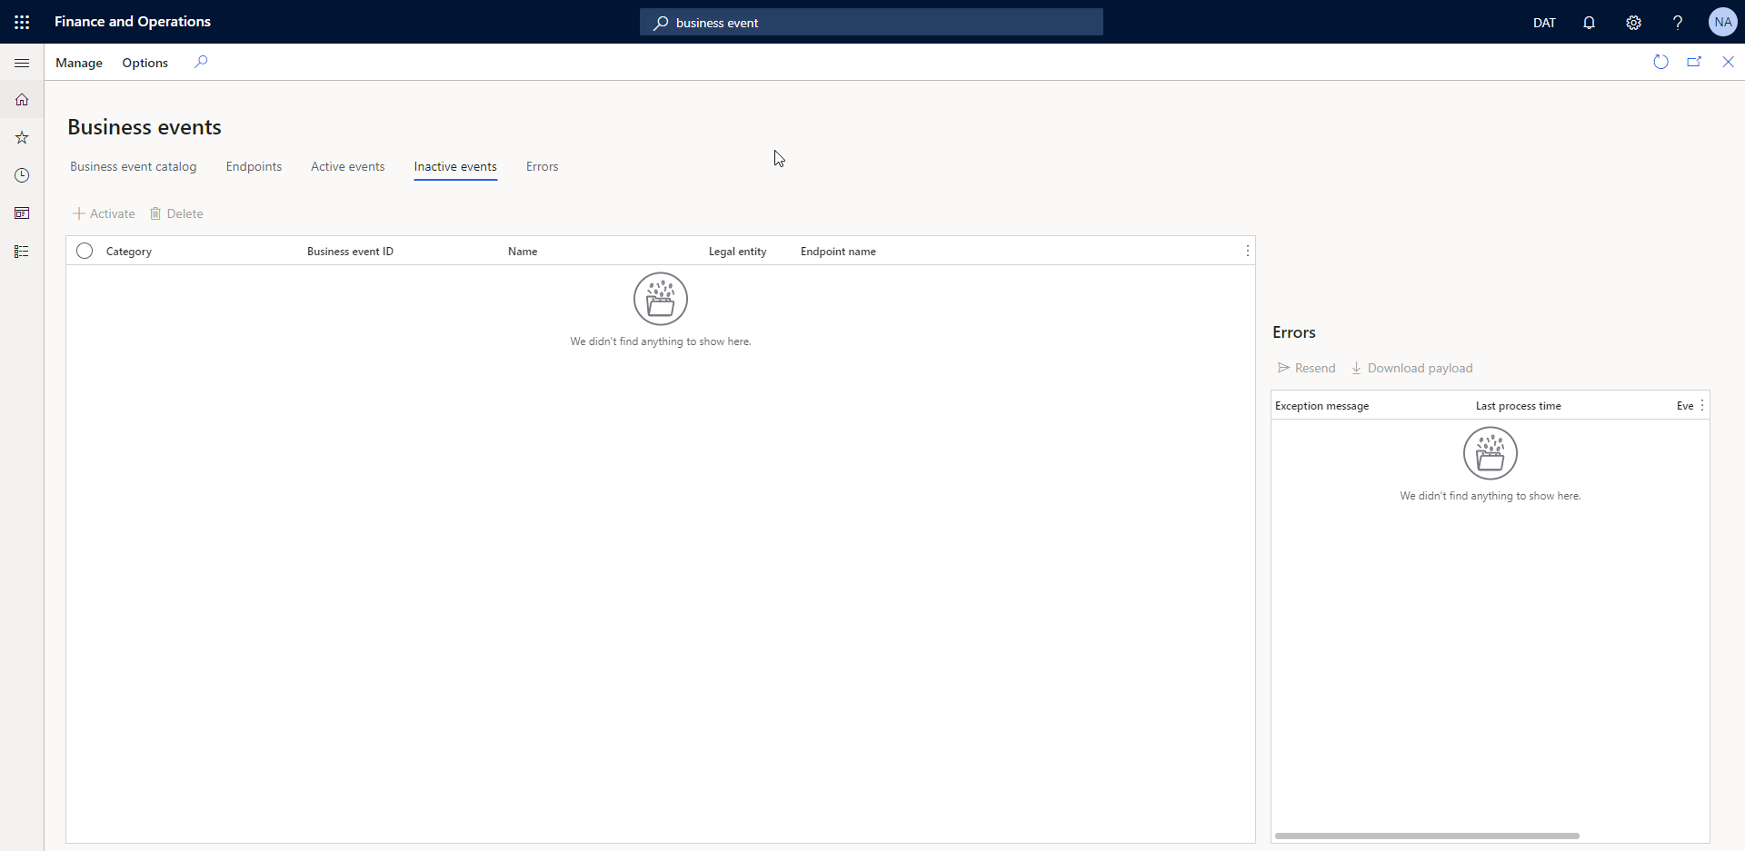
Inactive Events

Slide 59
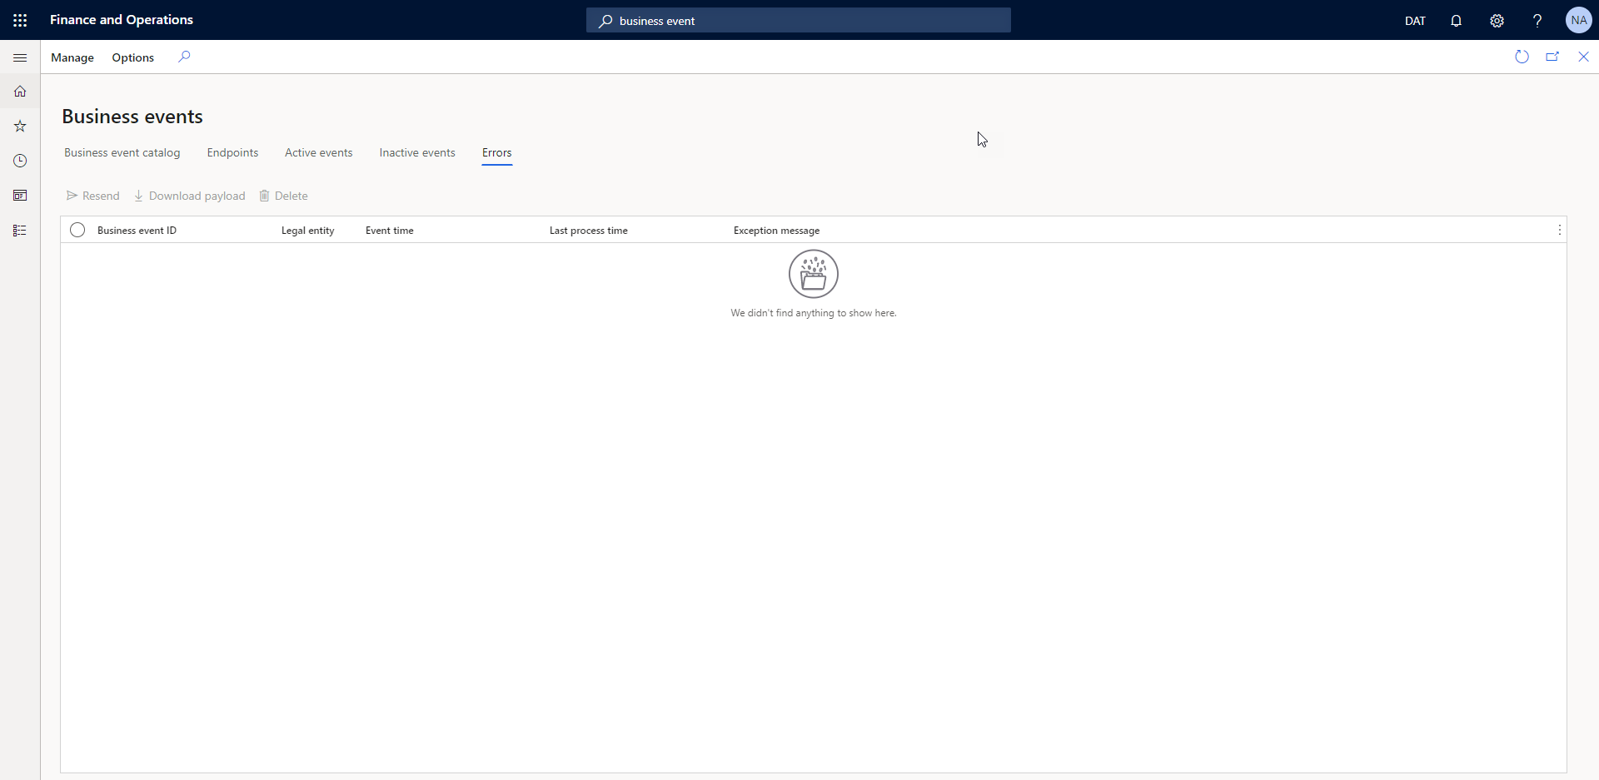
Errors

Slide 60
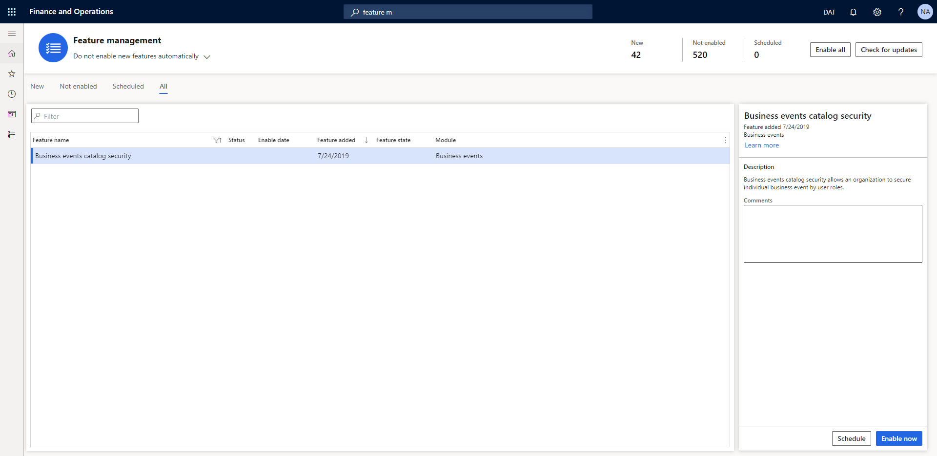
Security

Slide 61
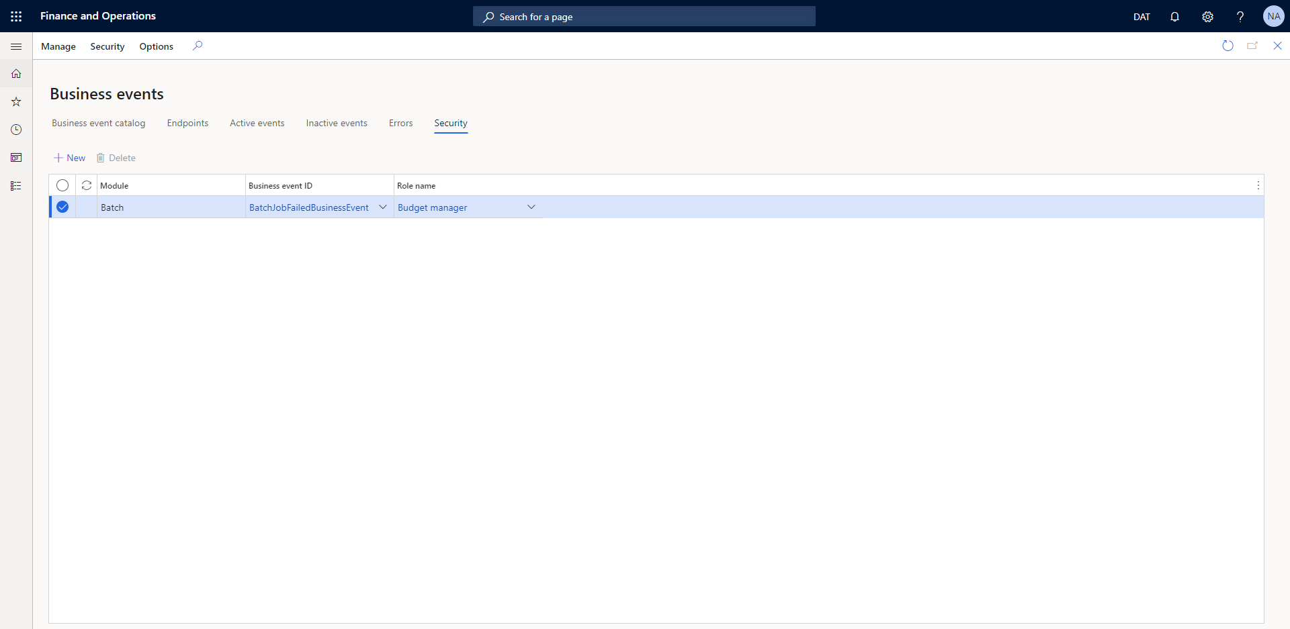
Security

Slide 62
Resources
https://docs.microsoft.com/en-us/dynamics365/fin-ops-core/dev-itpro/business-events/home-page
https://docs.microsoft.com/en-us/azure/event-hubs/event-hubs-about
https://docs.microsoft.com/en-us/azure/event-grid/compare-messaging-services
https://d365bits.com/2020/06/14/how-to-create-business-events-in-dynamics-365-finance-and-operations/
https://dynamics365musings.com/how-to-setup-d365-business-events-part-1/

Slide 63
Questions?

Slide 64
Dynamics 365: Let’s talk Upgrade Rollout Approach (AX 2012 Upgrade Series: Part 6) – Tuesday @ 2:00
Dynamics 365 F&O Licensing, Upgrades, Costs and More (Part 2) – Tuesday @ 3:00
Retail and Warehousing: The Biggest Areas for Change in Dynamics 365 F&O (AX 2012 Upgrade Series: Part 3) – Wednesday @ 9:30
AX Sucks. Let’s talk Upgrades (AX 2012 Upgrade Series: Part 1)– Wednesday @ 10:30
An AX2012 Upgrade Journey - Wednesday @ 11:30
Dynamics 365 F&O Business Events From End to Start to End – Wednesday @ 1:40
Dynamics 365 F&O Upgrade Tech Talk: Code, Customizations, Extension and Power Platform (AX 2012 Upgrade Series: Part 5) – Thursday @ 10:00
How To Get The Most Out of Your Upgrade (AX 2012 Upgrade Series: Part 2) – Thursday @ 1:10

Slide 65
Nathan’s Other Presentations
Dynamics 365 F&O Business Events From End to Start to End – Wednesday @ 1:40
Dynamics 365 F&O OData From Zero To Hero – Thursday @ 9:00
F&O Integration Roundup - Thursday @ 11:00
X++ Development Tips and Tricks plus D365FO.Tools! – Thursday @ 2:10

Slide 66
Give Away!

Slide 67

Please visit our booth
enVista booth #700
Meet with our experts
Learn about industry-leading practices
Get the most from your Microsoft investments
Register to win a YETI™ cooler
enVista
Booth
Hall C Entry

Slide 68
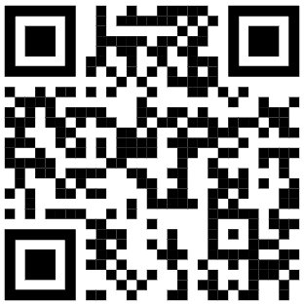
Survey Code

